Slide 1
Make It Stand: Balancing Shapes for 3D Fabrication
Romain Prévost
Emily Whiting
Sylvain Lefebvre
Olga Sorkine-Hornung
ETH Zürich
ETH Zürich
INRIA
ETH Zürich

Slide 2
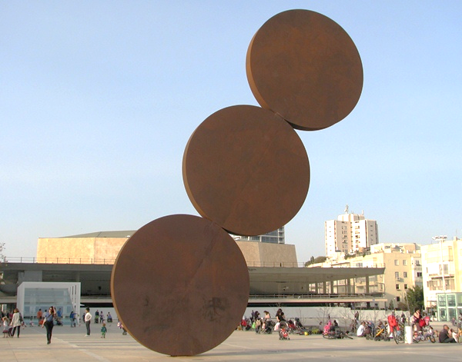
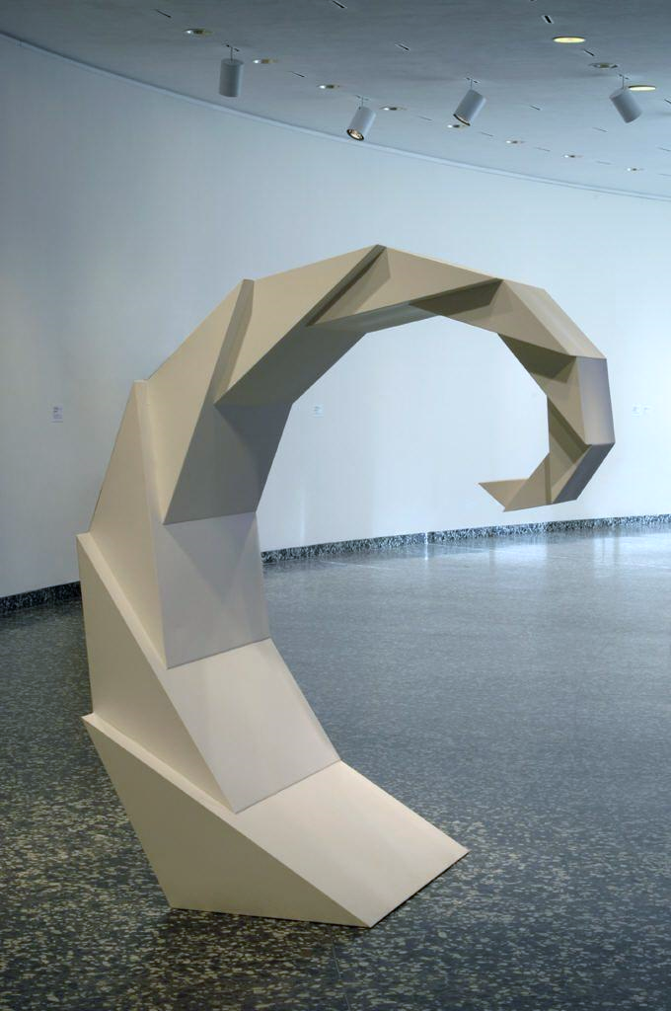
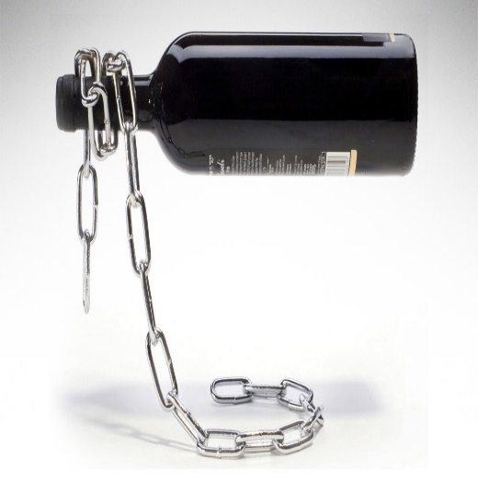
Motivation
Notes:
Balance is a delicate compromise between shape, weight and pose.
It can be difficult to visually assess whether a given object is properly balanced.
Artists, designers and architects use this to their advantage to produce surprising and elegant designs that seem to defy gravity.

Slide 3
Motivation
Notes:
The balancing process is challenging when manipulating geometry in a 3D modeling software.
There is usually no indication of gravity, support or weight.
In fact, volumes are only represented by their boundaries.
So it can be quite unintuitive to change the weight distribution.
With the advent of 3D printing technologies, we can produce physical realizations of 3D models.
However if the shape is difficult to balance the printed object will often fail to stand.

Slide 4
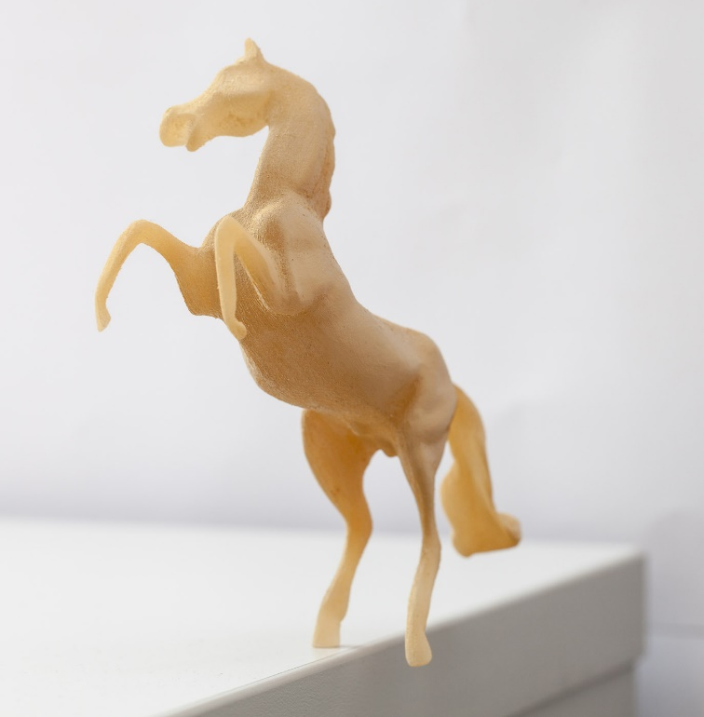
Make it stand
Notes:
In this project, we assist users in modifying existing 3D models to create balanced designs.
The user can interactively edit a shape and the optimizer constantly improves the design to ensure that, after printing, it will stand on its intended basis with the chosen orientation.
This is especially well suited for the modeling of surprising balance configurations.

Slide 5
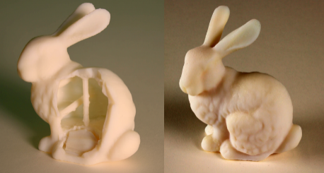
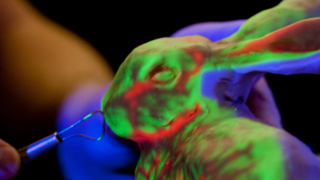
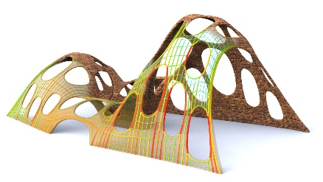
Previous work
printability
[Telea and Jalba 2011]
[Saul 2011]
[Stava 2012]
[Luo 2012]
fabrication technology
[Rivers 2012]
[Chen 2013]
[Vidimce 2013]
structurally-sound modeling
[Shi 2007]
[Umetani 2012]
[Vouga 2012]
[Whiting 2012]
[Panozzo 2013]
[Liu 2013]
Notes:
In the recent years there has been a lot of research going on about 3D printing and fabrication in general.
In particular, advanced methods have been developed to make a model printable.
While people have been focusing on structural soundness to prevent a 3D printed object from breaking under its own weight, we are interested in optimizing its balance.
We draw inspiration from the work on structurally-sound modeling, but we are not restricted to a particular representation which is often the case in architectural applications.
Moreover we avoid adding external structures such as struts or an heavy pedestal.

Slide 6
Method overview
Notes:
Let’s start with a proper description of the problem we are trying to solve.

Slide 7
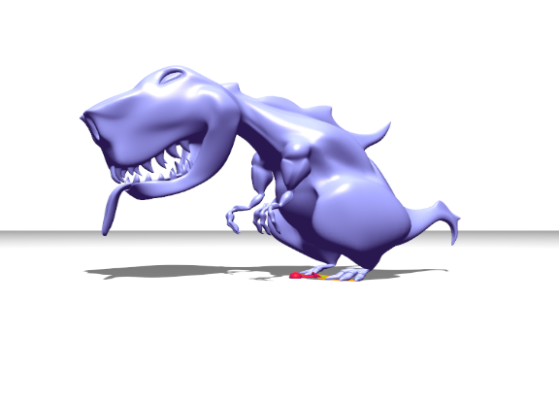
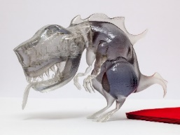
Problem formulation
input model
balanced model
inner carving
shape deformation
Notes:
We have an input surface representing a solid object.
Even though it is represented only by a surface, you have to think of it as a volume.
Our goal is to modify this volume such that once printed the model stands.
To do so, we manipulate the volume in two ways:
We carve inside the model to create inner voids.
But because this might not be enough we also consider deforming the model.
Overall these two manipulations change the mass distribution and thus the center of mass position.

Slide 8
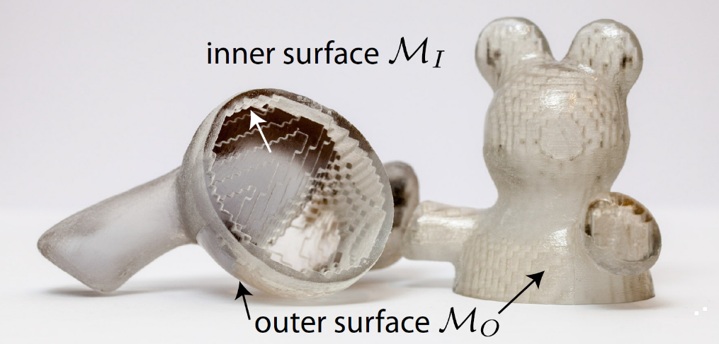
Problem formulation
Does it stand?
Does it look like
the initial shape?
Notes:
In the end, our method generates two output meshes, MO and MI , defining the outer and inner surfaces of the result visible here on this cut-open printed model.
MO is just a deformed version of the original mesh and MI is the inner surface representing the boundaries of interior voids.
When we have these two meshes we have all the information we need to 3D print the object.
We can formulate our objective as an energy to minimize in which the inner and outer surfaces become our variables.
This energy is a combination of two terms.
The first one ECOM measures if the model stands.
The second one EM measures if the deformation of the model is acceptable.
Note that it only depends on the outer surface since modifying the inside does not modify the visual appearance of the model.
Now I will detail how we define both of these terms.

Slide 9
Does it stand?
gravity
center
of mass
support polygon
Notes:
Feasible standing positions for a model are assessed by the location of the center of mass c in relation to the intended base of support.
The base of support is defined by the convex hull of all the points of the mesh touching the ground, which we call the support polygon. Here in orange.
The physics then tells us that the object will stand if its center of mass c projects along the gravity direction into this support polygon.
Thus, we can define a target c* anywhere inside this polygon.
But while it is sufficient to stand, we ensure some stability criterion by choosing c* in a safe region. Here in green.
The more stability the user wants, the smaller the green area becomes.
With this definition, it is easy to define the first term of the energy.
We simply use a squared distance between the current center of mass c and its target c* after projection on the ground plane.
In fact, if the center of mass projects onto this target then we know the model is standing and is stable enough.
Assuming a constant density, the mass and the center of mass can be computed analytically from the geometry of the two surfaces using the divergence theorem. We use an exact formulation which is important for delicate balance.

Slide 10
Does it look like the original shape?
Laplacian-based energy [Sorkine 2004]
Matrix based on initial mesh
Quadratic → gradient easy to compute
Invariant to global translation, scaling and small rotation
Current mesh position
Notes:
The idea behind the second energy term is to preserve the original shape.
We formulate this shape-preserving energy using the Laplacian of the original mesh with implicit rotations.
Basically it tells us how far the current mesh is from the initial one.
It has a lot of benefits.
In particular it is quadratic so we can easily compute its gradient.
Moreover the energy is invariant to global translation, scaling and small rotation so it only focuses on surface details.

Slide 11
Inner carving
inner carving
shape deformation
Notes:
Within this nice energy framework, we have two degrees of freedom to exploit: carving inside the volume and deforming it. First I will detail how we perform the inner carving phase.

Slide 12
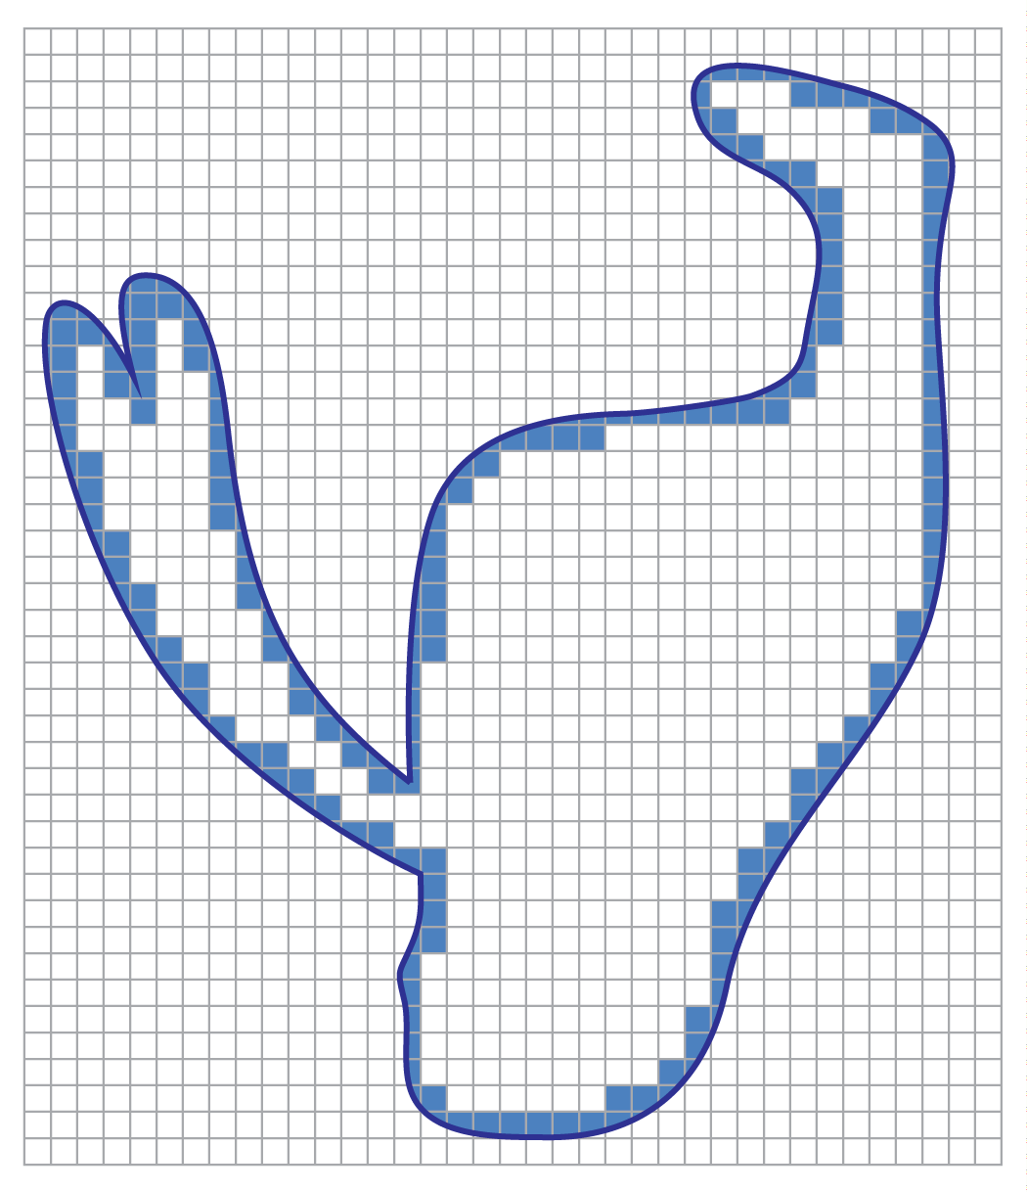
Variable reduction
t_{min}
Arbitrary inner surfaces
?
Voxel grid
Floating
component
Notes:
Optimizing for an arbitrary inner surface would be too difficult.
In particular because it would be tricky to avoid self-intersections and to control the mesh complexity.
Instead, we compute a voxel grid as a discretized representation of the volume inside the model.
Each voxel is assigned a binary value saying if it is filled or empty. We enforce some minimal thickness by simply disallowing to carve the voxels near the boundary.
We obtain the inner surface by taking the boundaries of the carved regions.
The volume discretization is computed once at the beginning and later deform together with the surface.
But even with these simplifications the problem remains difficult to solve.
In particular because we have topological constraints which are very difficult to express in an optimization framework. For example, we cannot allow disconnected components.
Besides we want the whole pipeline to be interactive so that the user can explore various designs during the optimization, so we need a fast algorithm.

Slide 13
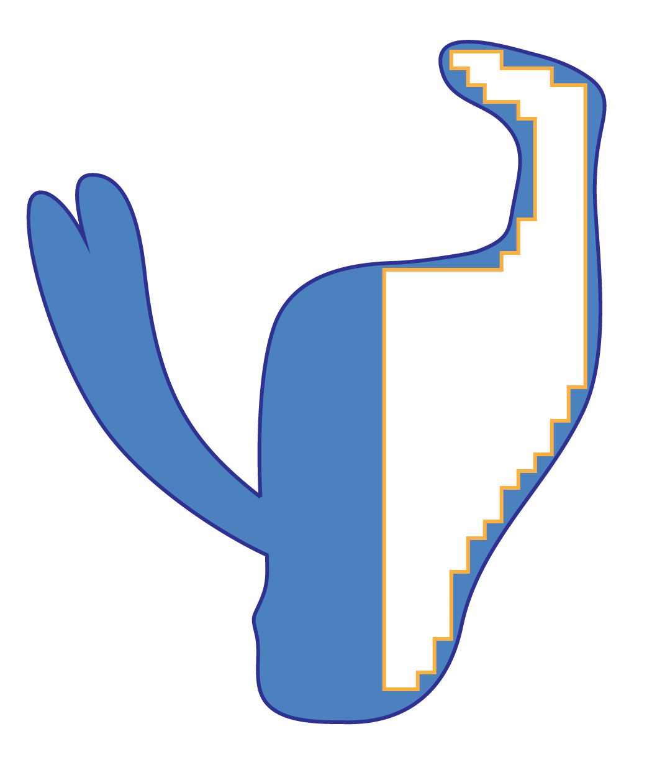
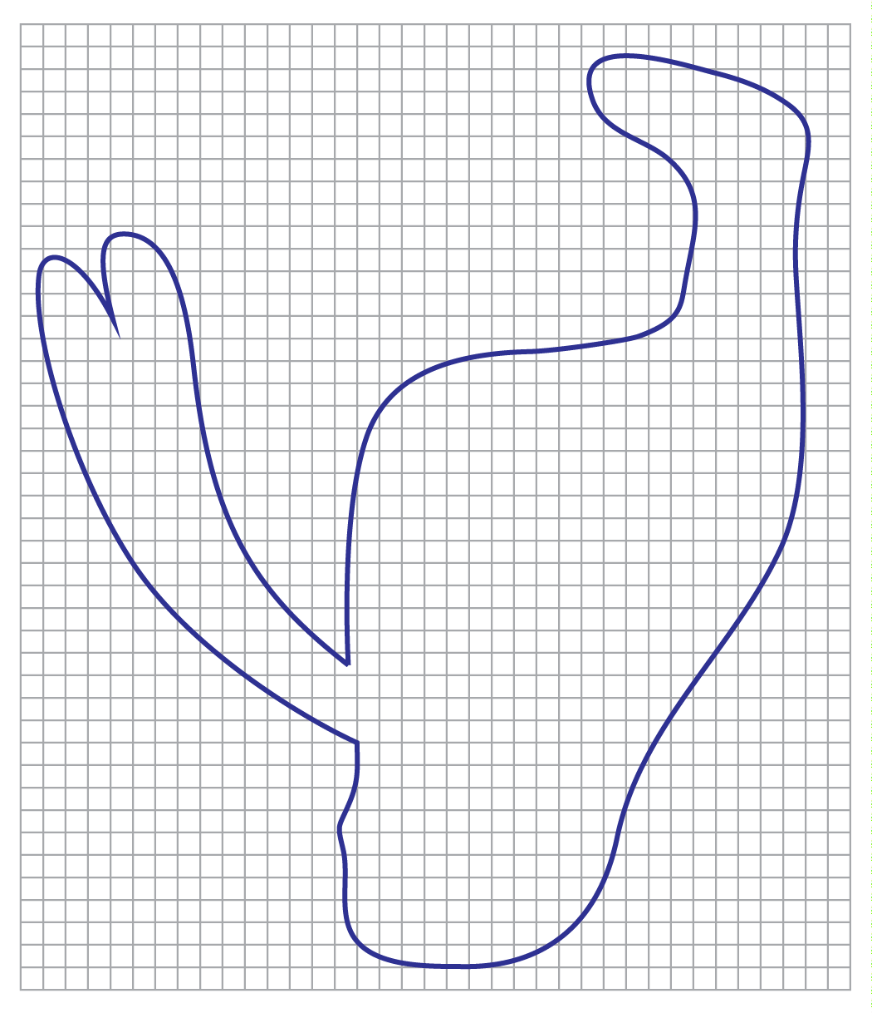
Optimal plane heuristic
Energy
Notes:
In our solution, we initialize all the voxels to be filled.
Given the current center of mass c and the target, imagine a plane perpendicular to the projected direction (c,c*). (here in green)
Carving the voxels located on the right side of c* potentially brings the center of mass closer to the target and may decrease the energy.
However, the filled voxels located on the left cannot help bringing the center of mass closer to the target.
So we remove these voxels one by one from right to left, and keep track of the energy.
When all the voxels have been processed, we pick the carve pattern that corresponded to the lowest energy value.
[This inner surface is attached to the voxel grid so it will deform with it in the second stage.]
While in 2D this heuristic give the right answer, in 3D it only produce approximate.
However it greatly benefits performance and in practice it is a pretty good approximation.

Slide 14
Shape deformation
inner carving
shape deformation
Notes:
But creating holes inside the model might just not be enough for delicate cases. That’s why we also allow shape deformations.

Slide 15
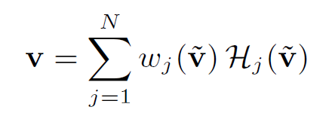
Deformation subspace
Linear Blend Skinning
Handle
transformation
Smooth and intuitive deformations
Reduced number of variables
Weights
Sum over handles
[Jacobson 2011]
Notes:
Instead of moving vertices one by one, we manipulate the shape using deformation handles.
In fact, we expect small changes impacting large portions of the model to be the most useful to optimize for stability.
We use the linear blend skinning deformation model with bounded biharmonic weights for parameterizing the deformation.
Basically the user places a small number of handles within the shape’s volume. We precompute the weights. And the whole geometry is then controlled by these handles transformations.
The video shows you how it looks.
You can see here the weights corresponding to each handle ranging from 1 in red and 0 in blue.
And what happen if I change the scale of the handle located in the head.
Overall, parameterizing the deformation with the handles serves two purposes:
First, it confines our optimization to a well-behaved shape subspace which also helps to preserve the shape.
And second it drastically reduces the number of variables.

Slide 16
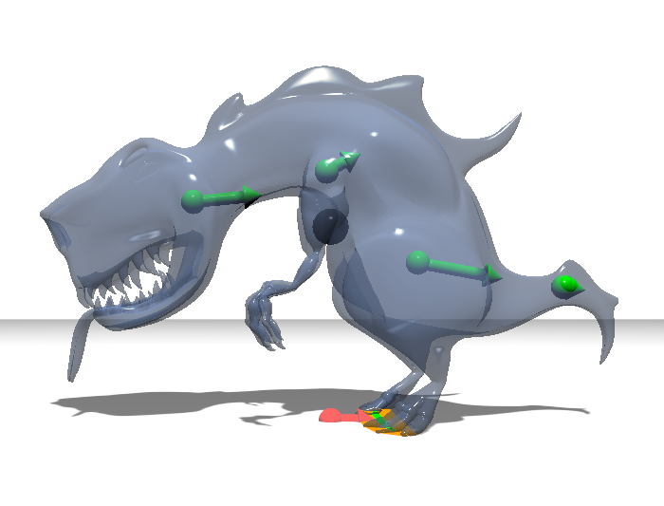
Deformation optimization
Energy gradient w.r.t. handles:
Translation
Scale
Gradient descent:
Notes:
The full energy is reformulated as a function of the handles transformations.
It’s a nonlinear optimization problem. But we can relatively easily derive analytic formulas for the gradient of the energy, so we can perform a gradient descent.
We restrict the optimization to the translation and scaling parameters, which correspond to four scalar variables for each handle. We use the new optimized parameters and the linear blend skinning formula, to update the surfaces and the voxel grid.
One of the main benefit of this approach is that the user can at any time take control over the optimizer which make interactivity a key feature of the 3D modeler. In fact, I will show during the demo that the user can manually set the handle transformations.

Slide 17
Full pipeline
Fix: handles
Fix: voxels
Optimize:
voxel fill
Optimize: handle
transformations
inner carving
shape deformation
Notes:
So I have described all the components of our system, and now I will show you how it all fits together. The optimizer works iteratively. In a first stage we fix the handles and solve for the interior voids using our inner carving algorithm. In a second stage we fix the inner surface topology and optimize for the handle transformations using our gradient descent.

Slide 18
Full pipeline
Fix: handles
Fix: voxels
Optimize:
voxel fill
Optimize: handle
transformations
inner carving
shape deformation
Notes:
We iterate these two steps until we converge to a standing and stable enough position.
For simple object with large support, the carving stage might be enough, in which case the optimizer stops at the first iteration without deformation of the shape. However, for delicate balance deformations are required.

Slide 19
Live demo

Slide 20
Results
Notes:
Let’s see some results now.

Slide 21
Armadillo – Ballet pose
x2
Notes:
This Armadillo would not initially stand on its right foot. You can see how our optimization carves and deforms the model. And here is the 3D printed version.

Slide 22
Armadillo – Kick pose
x2
Notes:
Here is a second example. This pose was also designed for animation and would fall over if fabricated. Again here is the printed result after optimization.

Slide 23
Suspension mode
Notes:
We can also apply our method to suspended objects.
The user is free to choose the suspension point anywhere on the surface, as well as the desired orientation of the object.
To achieve equilibrium the optimizer sets the target c* at the suspension point.

Slide 24
Multiple bases
Notes:
The method also supports multiple targets, by modifying the balance term of the energy and adapting the carving algorithm.
So we can optimize a single model for multiple poses.
We have a selection of models on stage, so if you want to check them out, you can join me at the end of the session.

Slide 25
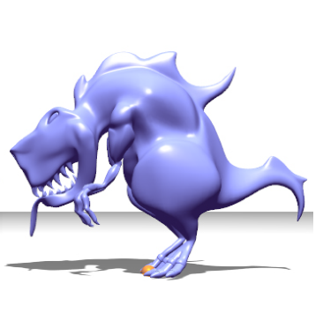
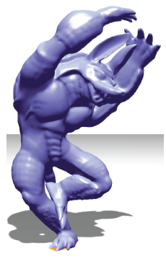
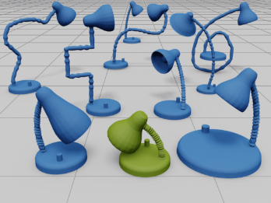
Discussion
Limitations
Future work
Handles placement
Multiple densities
Other deformation strategies
Self-intersections
[iWIRES 2009]
Notes:
In practice our algorithm turned out to be very robust.
However, a few problems can eventually occur.
First, a poor choice of handles will likely result in visually unpleasing solutions.
Second, it is possible in extreme cases for user deformations to lead to collisions between different model parts.
[A direction for future work could involve preventing these self-intersections.]
For future work we think there are many exciting directions to explore.
For example we have been focusing on printing single material models.
But we could extend to printing with varying densities.
Also our deformation framework relies on skinning techniques which is great for organic shapes, but having deformations that take shape semantics into account would be very beneficial for human-made designs.

Slide 26
Conclusion
Automatic balancing
Stability & shape preservation
Inner carving & shape deformation
Notes:
We presented a method to ensure stability of printed models so that they may be physically realized.
It combines stability objectives with shape preservation measures in order to respect the user’s original design.
We leverage the use of interior voids to manipulate the mass distribution without affecting the exterior appearance of the model as well as shape deformations to extend the freedom of the optimizer.
In conclusion, I would say that Make it stand is an example of how 3D modeling can become an interactive process where the computer is taking care of a difficult specific task, in our case optimizing the balance, while the user can focus on the actual visual result.

Slide 27
Acknowledgments
Daniele Panozzo
Philippe Block
Ladislav Kavan
Amit Bermano
Bernd Bickel
Alec Jacobson
Markus Buehler
Gioacchino Noris
Ronnie Gaensli
Steven Poulakos
Models:
www.turbosquid.com
archive3d.net
AIM@SHAPE
Funding:
Swiss National Science Foundation
European Research Council
Adobe Research
ETH Zurich Postdoc Fellowship
Notes:
We'd like to thank the following people for their help, and the following funding agencies for making this work possible

Slide 28
Make It Stand: Balancing Shapes for 3D Fabrication
Romain Prévost, Emily Whiting, Sylvain Lefebvre, Olga Sorkine-Hornung
Thank you!
Notes:
Finally I would like to thank my co-authors and thank you for listening to my talk.

Slide 29
Energy validation
No carving
No shape
preservation
Initial
(unbalanced)
Our
solution
No inner
carving
No shape
preservation

