Slide 1
Pattern-Based Quadrangulation for N-sided Patches
Symposium on Geometry Processing 2014
Kenshi Takayama
Daniele Panozzo
Olga Sorkine-Hornung
ETH Zurich

Slide 2
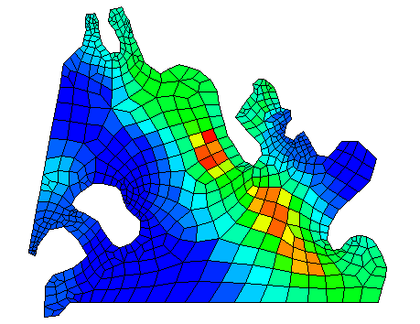
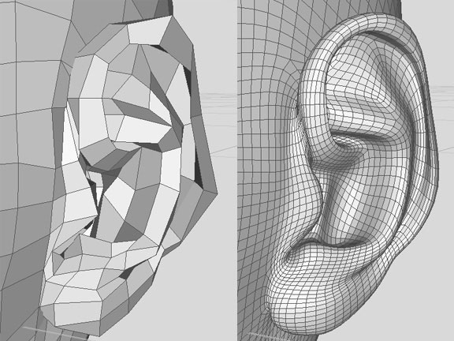
Quad meshing is important
Subdivision surfaces
Finite element analysis
Notes:
Our work is about quad meshing, which is important for modeling virtual characters using subdivision surfaces, as well as for finite element analysis in the engineering context

Slide 3
Sketch-based approach [Takayama13]
User:
Sketches curves ➔ N-sided patches
Notes:
Last year at SIGGRAPH, we presented a sketch-based approach to quad meshing where the user sketches curves on the input surface geometry which define a layout of N-sided patches.

Slide 4
Sketch-based approach [Takayama13]
User:
Sketches curves ➔ N-sided patches
Specifies num of edge subdiv
System:
Quadrangulates each patch
We propose a new algorithm
Notes:
The user also specifies the number of edge subdivisions at each of these curves.
Taking this information as input, the system quadrangulates each of these patches individually.
In this work, we propose a new algorithm for this N-sided patch quadrangulation task

Slide 5
Sketch-based approach [Takayama13]
x4 speed
Notes:
Here’s a screen capture of the system in action.

Slide 6
Problem definition
Input:
Num of edge subdiv at each side
Output:
Quadrangulation satisfying the input
l₂=1
l₁=2
valence-5 singularity
valence-3 singularity
l₀=5
Note:
∑_{i} l_{i} must be even
4 #F = 2 #E_{interior} + #E_{boundary}
Singularities at boundary
Valence counted accordingly
Topology only
Geometry by Laplacian smoothing
Notes:
Here’s a formal definition of the problem:
The input is a number of edge subdivisions for each side of the patch,
and the output is a quadrangulation that satisfies this input number of edge subdivisions at the boundary
Throughout this talk, singularity vertices are shown as colored dots.
There are a couple of things to note here:
first, the sum of the input numbers of edge subdivisions must be even.
This is a theoretical requirement due to a simple relation between the number of faces and the number of edges in the patch,
and there’s absolutely no way of generating a pure quad mesh if this requirement is not met,
Second, we allow singularities to exist at the patch boundary. So the valence of a vertex at the patch boundary is counted accordingly.
And finally, we only deal with the topology or the mesh connectivity. The geometry (the vertex positions) is obtained simply by the Laplacian smoothing

Slide 7
Problem examples
5
1
1
2
9
8
4
1
2
1
1
1
3
8
5
9
5
Notes:
Here are a couple of more problem examples.
In addition to triangular patches, our algorithm can handle two-sided, rectangular, pentagonal, and hexagonal patches.
Currently we don’t support higher N-gons because their practical relevance seems limited.

Slide 8
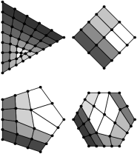
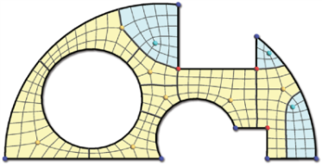
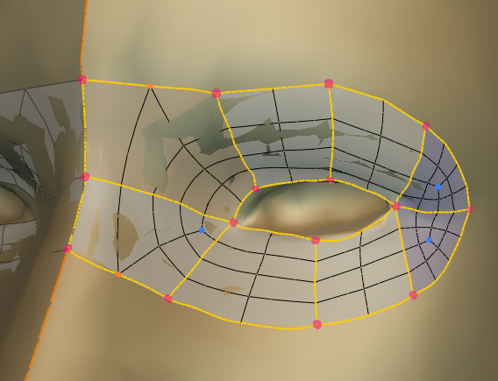
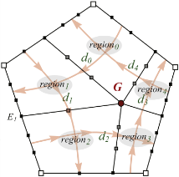
Previous work
2
1
4
Advancing front [Schaefer04]
Greedy heuristic
[Peng14]
1
5
2
Complicated formulation
Smaller set of patterns
4
2
Pattern-based [Nasri09,Yasseen13]
Ours:
Guaranteed to work for arbitrary cases
Don’t work when num of
edge subdiv is extremely small
Our SIGGRAPH paper [Takayama13] ➔ main focus on the UI
Notes:
The problem of quadrangulating N-sided patches has already been addressed in the literature using various approaches, such as
advancing front and greedy heuristic algorithms.
The most related to ours is a pattern-based approach proposed by Nasri et al and Yasseen et al.
The main differences are that they use a more complicated formulation and a smaller set of patterns.
In any case, the most important drawback common to these previous methods is that they don’t work when the input number of edge subdivisions is extremely small.
which is actually a common case in the real remeshing scenarios.
Our algorithm is guaranteed to work for arbitrary cases including such extreme cases.
Note that our SIGGRAPH paper only covers the UI part, but not the algorithm part.
So this is the first time we officially present our algorithm.

Slide 9
Algorithm

Slide 10
Infinitely many cases to consider
...
4
5
5
9
16
13
11
8
7
Our idea: Reduce the problem into a smaller subproblem
Notes:
The most important question is how we can handle all the possible cases.
We need to consider infinitely many cases to consider, which seems hard
Our idea to tackle this difficulty is to reduce the problem into a smaller subproblem so that we can solve it more easily.

Slide 11
Reducing the problem by trimming
4x4 grid
3x1 grid
4
5
4
1
1
1
11
4
1
7
1
1
4
7
4
Maximally reduced
4
4
Reduced problem can be quadrangulated
4
5
4
4
3
⇒
4
1
1
Original problem can be quadrangulated
1
1
11
4
7
4
4
3
(Way of trimming is not unique)
Notes:
We propose an operation called trimming to reduce the original problem.
Let’s say we have this particular problem as input.
We can trim this input and split it into two pieces, one 4x4 regular grid at the top left and the remaining smaller triangle at the bottom right.
Now this smaller triangle is our reduced problem, which can be further trimmed to obtain a maximally reduced problem.
Here’s another depiction of the same decomposition.
Note that the way of decomposing the patch is not unique, and this is just one example.
An important thing to note here is that if the reduced problem can be quadrangulated, it means that the original problem can also be quadrangulated, because we can always trivially reverse these operations to come back to the original problem.

Slide 12
Reducing the problem by trimming
4
4
1
3
1
1
12
1
12
12
5
16
5
2
3
1
12
4
4
4
4
2
5
5
5
5
5
5
3
12
3
3
3
7
7
7
1
1
2
2
3
5
5
1
7
2
5
1
1
2
6
6
4
4
1
2
2
2
2
1
1
1
3
9
9
9
3
6
Notes:
Here are some more examples of maximally reducing the input problems, for rectangular and pentagonal patches

Slide 13
Reducing the problem by trimming
4
4
5
4
3
1
1
Common form of reduced problem:
1
1
1
4
11
4
4
3
4
5
9
1
6
1
1
1
3
9
1
6
1
8
3
1
4
α
6
16
13
16
10
1
10
1
How can we quadrangulate it?
1
6
6
7
6
1
1
Notes:
Here are three more examples of maximally reducing the problem for a triangular patch.
Interestingly, it turns out that the maximally reduced problem for a triangular patch always takes this common form
where two sides have only one edge while the other side has an arbitrary number of edges, denoted as alpha, here.
So now our question is: how can we quadrangulate this family of problems parameterized by alpha?

Slide 14
Topological pattern
Minimal quad mesh
Parameter x: num of edge loops inserted
x
x=0
x=1
x=2
...
4
6
8
4+2x
Notes:
To solve this problem, we propose to use what we call topological patterns.
Here is one of such topological patterns.
A topological pattern is a minimal quad mesh, which has a set of parameters.
For example, this particular pattern has a parameter x depicted as this blue arrow here.
x is a non-negative integer representing the number of edge loops inserted at this particular location.
For example, when x=0, there’s no edge loop inserted, and the number of edges at the bottom side is 4.
If x=1 or x=2, the corresponding number of edges are inserted and the number of edges at the bottom side is determined accordingly.
In general, the number of edges at the bottom side is simply expressed as 4+2x

Slide 15
Using topological pattern
Case I: α=2
Case II: α=4+2x
1
1
➔ already a quad
x
α
α must be even
Guaranteed to work for all the cases!
Notes:
So how can we use these topological patterns?
First, it’s important to note that alpha must be even, because the sum of the number of edge subdivisions at the boundary must be even.
Then, we can think of two cases:
One is the special case where alpha is 2.
In this case, it’s already a quad here, so we don’t need to do anything.
For all the other cases, alpha can be expressed as 4+2x,
which is exactly what the pattern shown in the previous slide can represent.
Therefore, our algorithm is guaranteed to work for all the possible cases.

Slide 16
Complete set of patterns
Notes:
and here is a complete set of patterns that guarantees that our algorithm always works for arbitrary cases.

Slide 17
Reduced input  topological pattern See the paper for more details
Input
Condition
(α, 1)
α=3+2x
(2, 2)
--
Input
Condition
α=2
(α, 1, 1)
α=4+2x
Pattern
Pattern
Input
Condition
(1, 1, 1, 1)
--
(α, 1, 1, 1)
α=3+2x
α=β=2+x
(α, β, 1, 1)
α=4+2x+y, β=2+y
Pattern
Notes:
Here is a list of all possible cases of reduced input and their corresponding topological patterns.

Slide 18
Reduced input  topological pattern See the paper for more details
Input
Condition
α=2
(α, 1, 1, 1, 1)
α=4+2x
α=2+x, β=1+x
(α, β, 1, 1, 1)
α=5+2x+y, β=2+y
Pattern
Enumerating reduced input is easy,
but finding patterns is hard (done by hand)
Input
Condition
(1, 1, 1, 1, 1, 1)
--
(α, 1, 1, 1, 1, 1)
α=3+2x
(α, β, 1, 1, 1, 1)
(α, 1, 1, β, 1, 1)
α=β=2+x
α=4+2x+y, β=2+y
α=β=1+x
α=4+2x+y, β=2+y
Pattern
Notes:
I don’t want to scare you with this exhaustive information. Please see the paper if you’re interested in more details.
I’d like to mention here that enumerating all possible forms of reduced input was relatively easy, but finding corresponding topological patterns was hard, which was done by hand in a trial-and-error manner.

Slide 19
How to trim the patch optimally?
1
1
4
6x4
7
7
4
1x2
1x1
1
1
2
5x4
Notes:
OK, so far we saw that our algorithm is guaranteed to work in arbitrary cases.
However, we are not done yet.
There remains a question about how to trim the patch optimally.
As mentioned before, there are generally multiple ways to trim the patch,
and depending on how we trim the patch, we end up with different quadrangulations with different number of singularities.
In this example, we usually prefer the one at the bottom which has only one singularity.
So, how can we do the trimming optimally?

Slide 20
Optimal trimming
x
p₀
p_{i}: padding parameter
( trimming)
Notes:
To answer this question, let’s take a closer look at the pattern we saw earlier.
In addition to the parameter x, this pattern has three more parameters, p0, p1, and p2 which represent padding to the sides, which is the inverse of trimming.

Slide 21
Optimal trimming
x
p₁
p₀
p_{i}: padding parameter
( trimming)

Slide 22
Optimal trimming
l₂
l₁
p₂
x
p₁
p₀
l₀
p_{i}: padding parameter
( trimming)
Notes:
And the number of edges at the boundary is determined by these parameters.

Slide 23
Optimal trimming
p₀=1
l₂
l₁
l₂=4
l₁=5
p₁=2
p₂
x
p₁
p₂
x
p₁
p₂=3
p₀
p₀
x=1
l₀
l₀=11
p_{i}: padding parameter
( trimming)
Notes:
For example, let’s substitute some numbers to these parameters.
If p0=1, one row of regular grid is added to the bottom side.
If p1=2, two rows of regular grid is added to the top right side.
If p2=3, three rows of regular grid is added to the top left side.
If x=1, one edge loop is inserted at the location of the blue arrow.
which results in these particular numbers of edges at the boundary.

Slide 24
Optimal trimming
p₀=1
l₂
l₁
l₂=4
l₁=5
p₁=2
p₂
x
p₁
p₂=3
p₀
x=1
l₀
l₀=11
p₀
p₁
p₂
x
0
1
1
1
0
1
1
1
0
2
0
0
4
1
1
l₀
l₁
l₂
+
=
Notes:
It’s easy to see that there is a simple linear relation between the parameters and the number of edges at the boundary.
The first column of this matrix means that adding one row of quads to the bottom side increments l1 and l2.
And the same idea for the second and the third columns.
The last column corresponding to the parameter x means that inserting one edge loop along the blue arrow increases l0 by two.

Slide 25
Optimal trimming
l₂
l₁
l₂
l₁
p₂
p₁
p₂
p₁
x
l₂=7
l₁=7
p₀
p₀
l₀=4
l₀
l₀
p₀
p₁
p₂
x
0
1
1
1
0
1
1
1
0
2
0
0
4
1
1
l₀
l₁
l₂
p₀
p₁
p₂
4
7
7
0
1
1
1
0
1
1
1
0
2
1
1
l₀
l₁
l₂
4
7
7
+
=
+
=
Notes:
And each of these patterns has its own system of linear equations.
Now we have numbers of edges at the boundary as the input, so let’s substitute them into the system.

Slide 26
Optimal trimming
f
maximize:
subject to:
∑_{i} p_{i}
A y = b
y  ^{M}
y ≥ 0
l₂
l₁
l₂
l₁
p₂
p₁
p₂
p₁
x
Non-negative integer solution?
p₀
p₀
l₀
Integer Linear Programming
l₀
p₀
p₁
p₂
x
6
0
0
0
0
1
1
1
0
1
1
1
0
2
0
0
0
6
6
0
1
1
1
0
1
1
1
0
p₀
p₁
p₂
5
1
1
2
6
6
=
=
Notes:
Bringing the constant vector to the right hand side, we end up with these equations.
Now our question is whether these equations have non-negative integer solutions.
And this is exactly the formulation of Integer Linear Programming, and you can use your favorite solver to solve it.
In this particular case, both of these patterns happened to have feasible solutions, which correspond to two different quadrangulations.
Our algorithm chooses the one with the least amount of singularities by default, but the user can also choose other options if desired.

Slide 27
Underconstrained system
y
Multiple feasible solutions
UI for exploring the solution space
Increment/decrement selected parameter
Different constraint & objective in ILP
A
b
=
x=0
x=1
x=2
Decrement x
Increment x
Notes:
As you might have noticed, the system of linear equations is generally underconstrained; the matrix is wider than taller.
This means that generally there could be multiple solutions that satisfy the input.
We propose a simple UI where the user can increment or decrement a certain selected parameter, as shown here.
This is achieved by using different constraints and objective in the ILP.

Slide 28
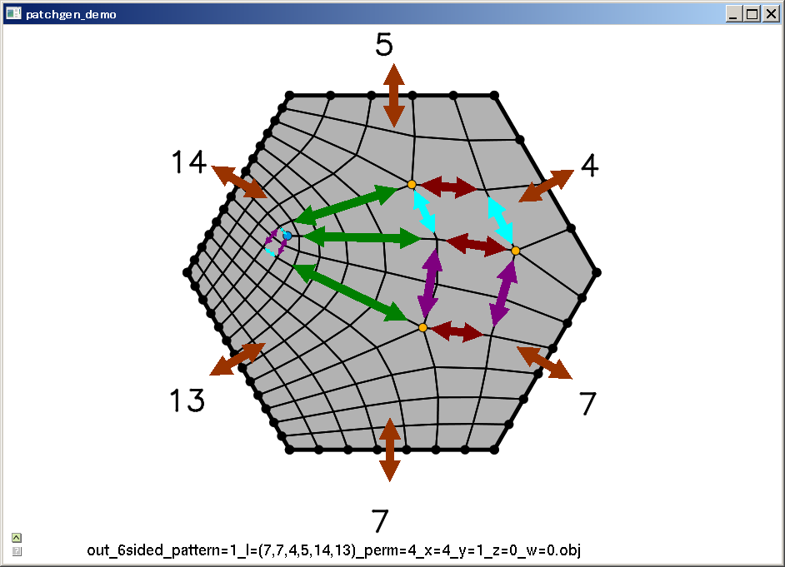
Demo
Notes:
(hide AntTweakBar menu)
[Change num of edge subdiv for 3-sided]
I can specify arbitrary num of edge subdivisions at any side of the patch, the quadrangulation is computed instantly.
The sum of the num of edge subdiv at the boundary must be even, otherwise it’s theoretically impossible to generate a pure quad mesh.
(Randomize num of edge subdiv)
Other than that, there’s no restriction.
[Adjust parameter with 3-sided (14, 6, 6)]
Each parameter is depicted as a set of colored arrows, and the currently selected parameter is shown brighter.
Here, this parameter represents the number of edge loops inserted between this pair of yellow and blue singularities.
Currently there’s one edge loop here, and if I increment the parameter, now we have two edge loops.
I can increment it further, or decrement it.
[Adjust parameter with 4-sided (8, 8, 6, 6)]
Adjusting the padding parameters for rectangular patches is conceptually equivalent to topologically translating the pair of singularities.
show hexagonal? skip?

Slide 29
Integrated into sketch-retopo system
[Takayama13]
Notes:
Here’s a screen capture of our algorithm integrated into the sketch-based system.
A hexahedral patch is used to cover the forehead of the bunny.
Two-sided patches are used to model the eye.
The area around the eye is filled with pentagonal patches.

Slide 30
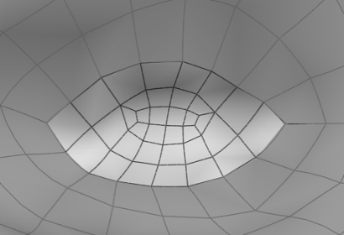
Future work
Better geometry optimization
More complex patterns
Generalization to higher N-gons
Generalization to hex meshing
Notes:
Finally I mention some directions for future work.
as mentioned before, the geometric optimization was not our main focus and the simple Laplacian smoothing we used can lead to flipped or badly shaped quads.
One direction for future work is to optimize the geometry in a better way, possibly taking the geometric features of the underlying 3D surface mesh into account.
Second, it would be nice if we could enrich the space of quadrangulations generated by our algorithm by adding more complex patterns.
Generalization of our algorithm to higher N-gons is an obvious direction for future work.
It seems difficult because the number of required patterns would grow exponentially for higher N.
You might wonder why not just simply split the patch into multiple pieces and quadrangulate them individually.
One drawback of this approach is that the user has to decide where to split the patch and how many edges to insert at the split.
Also in this approach the corner vertices at the patch split are always singularities, which is not necessarily desirable.
Finally, it would be great if we could generalize our approach to volumetric hexahedral mesh generation, which is especially relevant for the CAD industry.
But it seems overwhelmingly difficult; everything becomes much more difficult when you work with 3D volumes...

Slide 31
Thank you!
C++ code available at: http://igl.ethz.ch/projects/patch-quad/
Acknowledgements:
Alexander Sorkine-Hornung
Maurizio Nitti
ERC grant iModel (StG-2012-306877)
JSPS Postdoc Fellowships for Research Abroad

Slide 32
Equations for other patterns
l₂
l₃
l₂
p₂
p₃
p₂
x
l₃
x
l₁
p₃
p₁
y
y
p₄
p₁
l₄
l₁
p₀
p₀
l₀
l₀
p₀
p₁
p₂
p₃
x
y
p₀
p₁
p₂
p₃
p₄
x
y
0
1
0
1
1
0
1
0
0
1
0
1
2
0
0
0
1
1
0
0
4
2
1
1
l₀
l₁
l₂
l₃
0
1
0
0
1
1
0
1
0
0
0
1
0
1
0
0
0
1
0
1
1
0
0
1
0
2
0
0
0
0
1
1
0
0
0
5
2
1
1
1
l₀
l₁
l₂
l₃
l₄
+
=
+
=

Slide 33
Comparison
4
5
4
12
[Yassen13]
5
15
3
6
4
3
6
8
4
4
5
4
13
Ours
5
15
3
6
4
3
6
8
4

