Slide 1
A Sketch-Based Interface for Detail-Preserving Mesh Editing
Andrew Nealen Olga Sorkine Marc Alexa Daniel Cohen-Or

Slide 2
Ideas and Contributions
A sketch-based interface...
Feature modification (object-space silhouettes)
Feature creation (sharp features, ridges, ravines)
... For detail-preserving mesh editing
Adjust remaining geometry around the modified/created feature such that shape characteristics are preserved

Slide 3
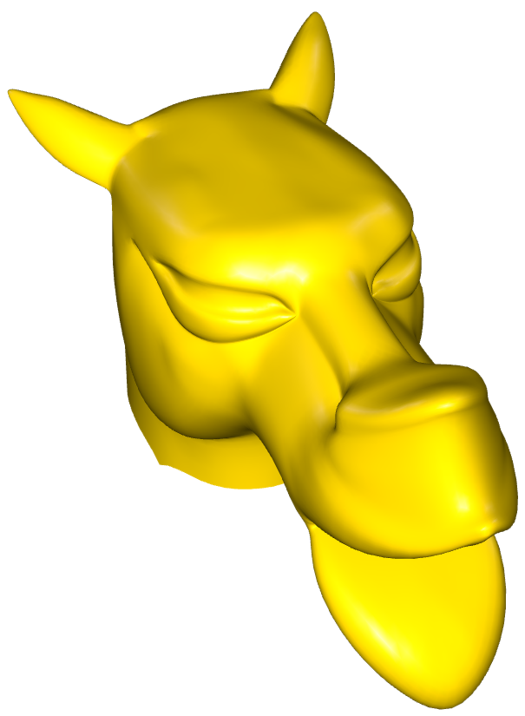
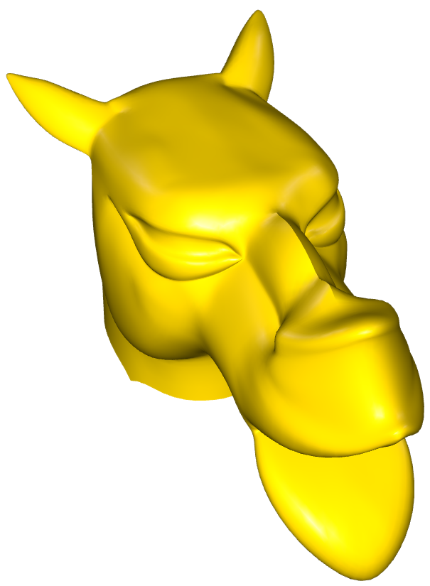
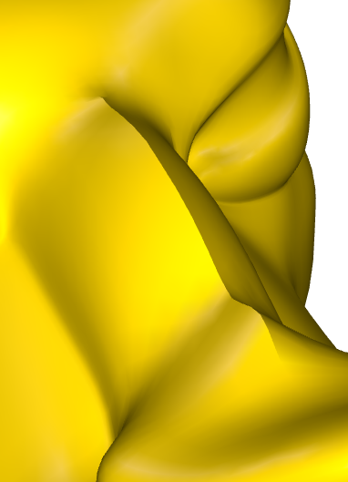
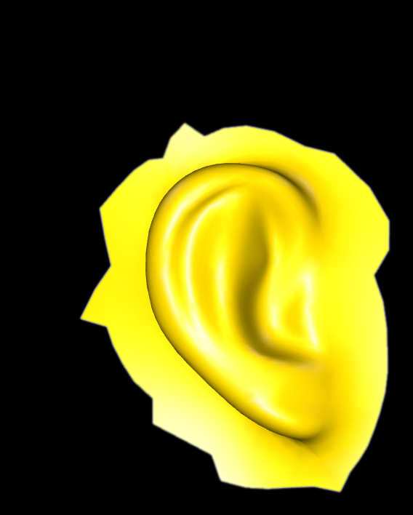
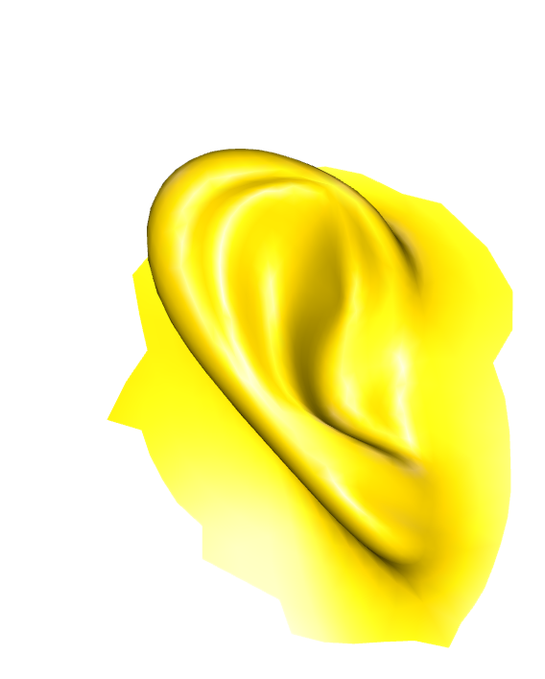
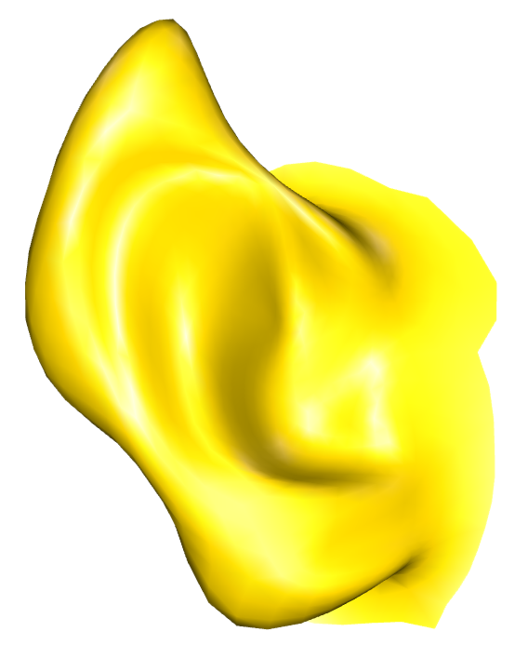
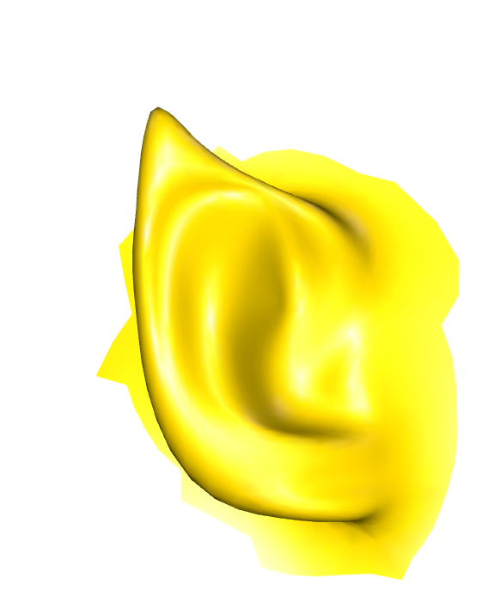
Ideas and Contributions
Silhouette sketching
Feature sketching
Sketching a shape can be interpreted as inverse Non-Photorealistic Rendering
A sketch-based modeling interface which uses silhouettes and sketches as input, and produces contours, ridges and ravines

Slide 4
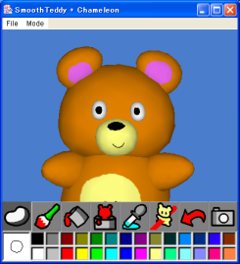
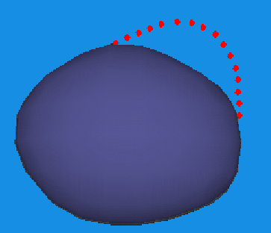
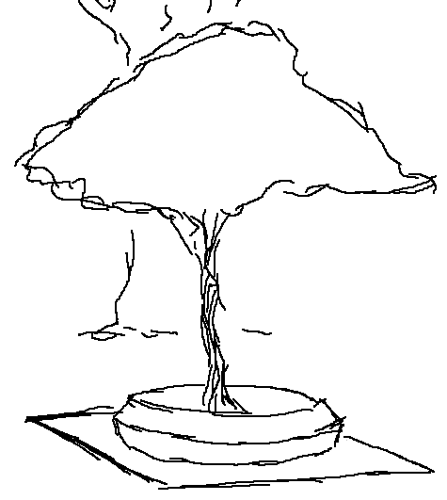
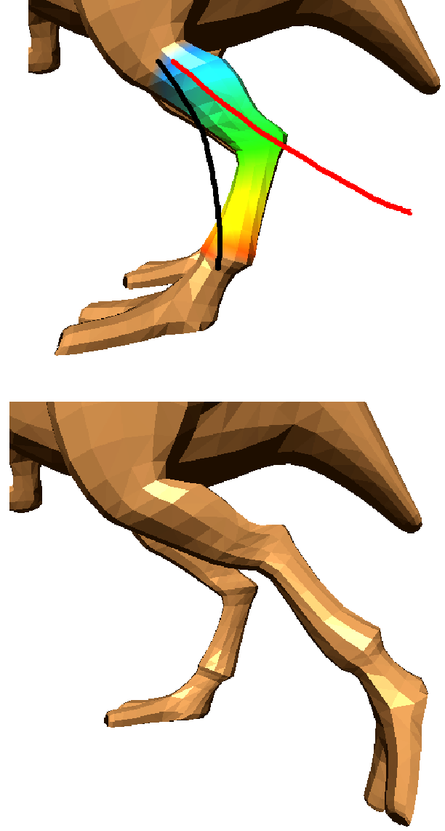
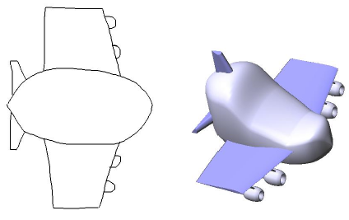
Sketch-Based Interfaces and Modeling
(Some) previous work
SKETCH [Zeleznik et al. 96]
Teddy [Igarashi et al. 99 and 03]
Variational implicits [Karpenko et al. 02]
Relief [Bourguignon et al. 04]
Sketching mesh deformations [Kho and Garland 05]
Parametrized objects [Yang et al. 05]
Many, many more... and (hopefully) more to come!

Slide 5
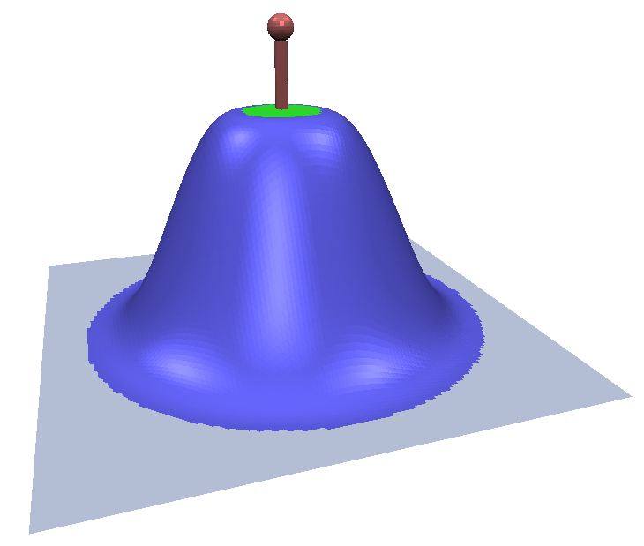
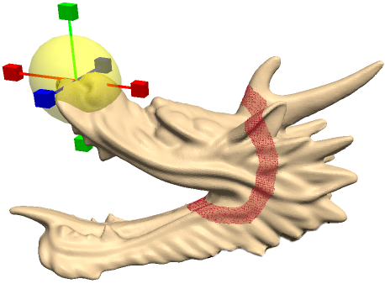
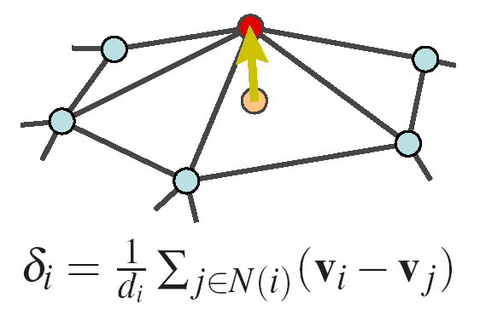
Inspiration and Motivation
The (affine) handle metaphor
Used in (almost) every editing tool
Nice, but can be unintuitive for specific editing tasks
Laplacian Mesh Editing
Preserve local detail after imposing editing constraints
[Botsch and Kobbelt 04]
[Sorkine et al. 04]
[Sorkine et al. 04] [Zhou et al. 05]

Slide 6
Mesh Modeling Framework
Discrete Laplacians
n
L
x
=
δ
δ_{cotangent} : w_{ij} = cot α_{ij} + cot β_{ij}

Slide 7
Mesh Modeling Framework
Surface reconstruction
n
L
x
δ_{x}
L
x
=
δ
y
δ_{y}
L
z
δ_{z}
δ_{cotangent} : w_{ij} = cot α_{ij} + cot β_{ij}

Slide 8
Mesh Modeling Framework
T_{i} (Rotation/Scale)
Implicit transformations
n
L/T_{i}
L
T_{i}
x
δ_{x}
L/T_{i}
δ_{y}
L
y
=
0
T_{i}
L/T_{i}
δ_{z}
L
z
Implicitly compute T_{i} transformations by comparing 1-rings of the deformed and non-deformed mesh
For the details see: Laplacian Mesh Editing [Sorkine et al. 04]

Slide 9
Mesh Modeling Framework
Surface reconstruction
n
L/T_{i}
T_{i}
x
L/T_{i}
y
=
0
T_{i}
L/T_{i}
z
fix
1
1
c₁
1

Slide 10
Mesh Modeling Framework
Editing operations
n
L/T_{i}
T_{i}
x
L/T_{i}
y
=
0
T_{i}
L/T_{i}
z
fix
1
edit
1
c₁
1
1
1
c₂
1

Slide 11
Mesh Modeling Framework
Least-Squares solution
n
w_{Li}
L/T_{i}
L
T_{i}
x
w_{Li}
δ_{x}
L/T_{i}
δ_{y}
L
y
=
0
T_{i}
L/T_{i}
δ_{z}
L
z
fix
1
w₁
c₁
edit
1
w₁
1
Normal Equations
1
w₂
c₂
1
w₂
A^{T}A
1
x
A^{T}
=
b
x
(A^{T}A)⁻¹
A^{T}
=
b
A
x
=
b

Slide 12
Silhouette Sketching
Using silhouettes as handles
Detect object space silhouette
Project to screen space and parametrize [0,1]
Parametrize sketch [0,1]
Find correspondences

Slide 13
Silhouette Sketching
Using silhouettes as handles
Detect object space silhouette
Project to screen space and parametrize [0,1]
Parametrize sketch [0,1]
Find correspondences
Use as positional constraints while retaining depth value

Slide 14
Silhouette Sketching
What is a good silhouette?
viewer

Slide 15
Silhouette Sketching
What is a good silhouette?
viewer
Illustrating Smooth Surfaces [Hertzmann and Zorin 00]

Slide 16
Silhouette Sketching
On edge constraints
n
w_{Li}
L/T_{i}
T_{i}
x
w_{Li}
L/T_{i}
y
=
0
T_{i}
L/T_{i}
z
fix
1
w₁
c₁
edit
1
w₁
edit
1
1
w₂
c₂
λ x_{i} + (1-λ) x_{j}
1
w₂
1
λ
1−λ
w₃
c₃
λ
1−λ
w₃
λ
1−λ

Slide 17
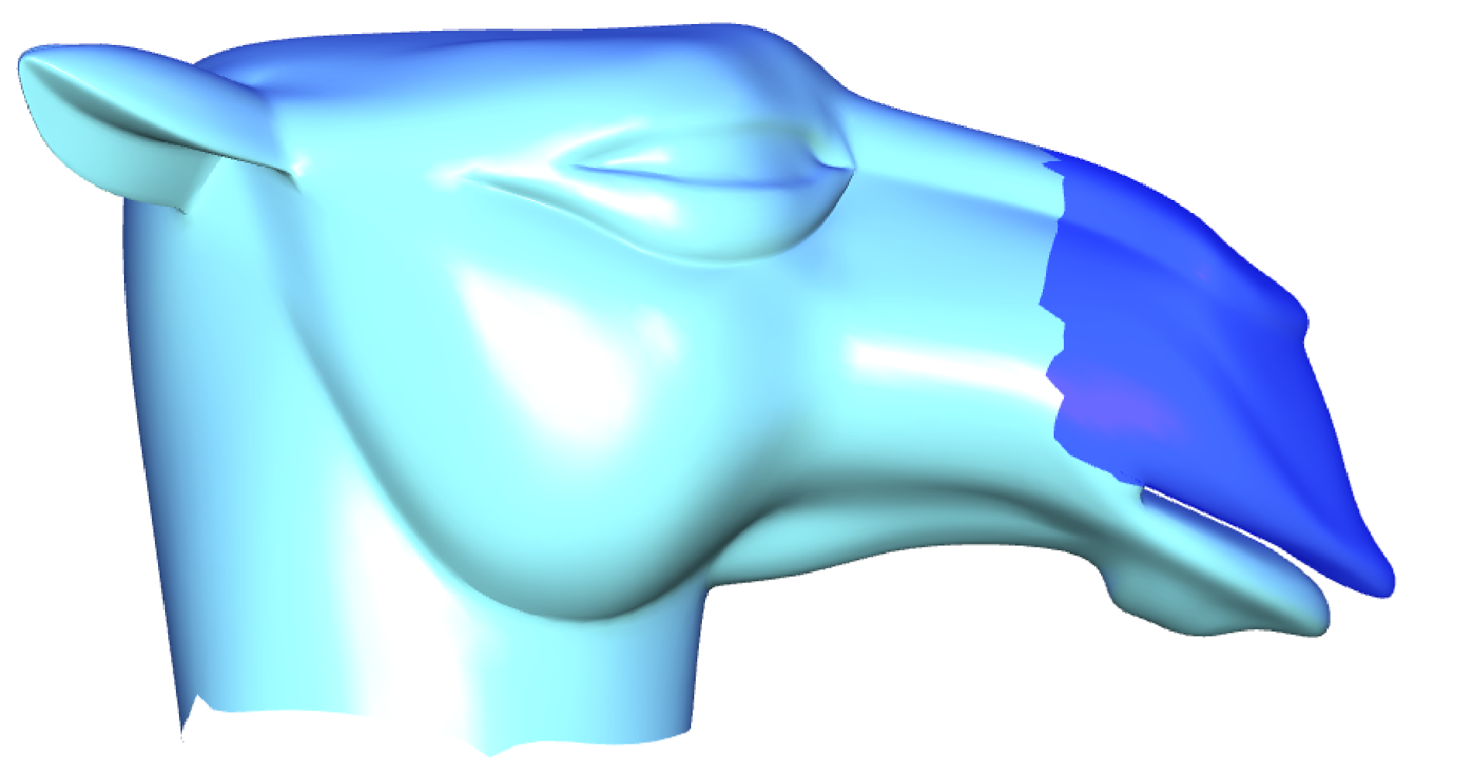
Silhouette Sketching
Approximate sketching
Balance weighting between detail and positional constraints

Slide 18
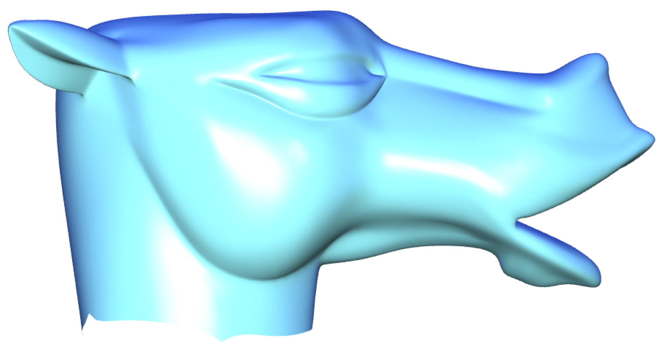
Silhouette Sketching
Approximate sketching
Balance weighting between detail and positional constraints

Slide 19
Feature Sketching
We wish to influence (discrete) differential properties of the mesh for arbitrary sketches
Possible solution
Cut existing polygons along the sketch and add new edges
Our solution
Adjust mesh geometry to lie under the sketch (as seen from the camera), while preserving mesh topology and ensuring well shaped triangles

Slide 20
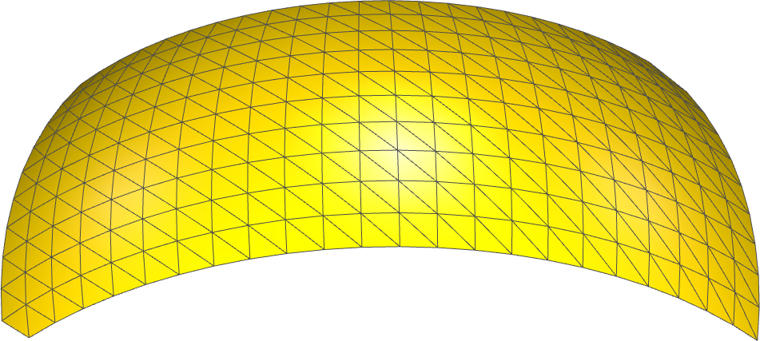
Geometry Adjustment
First: min cost edge path (close to sketch)
Potentially jaggy appearance
(orthographic) viewer
sketch
screen
n
v_{O}
v₂
v₁
(schematic) cross-section

Slide 21
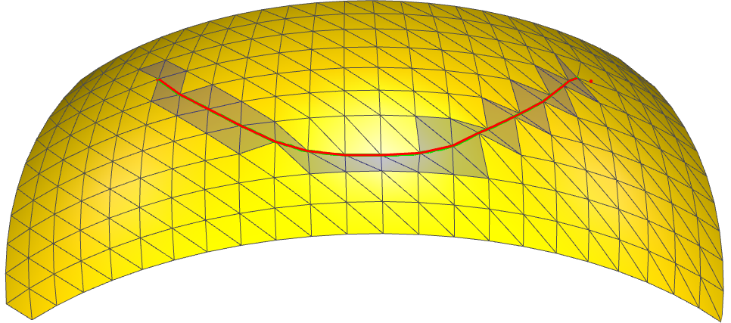
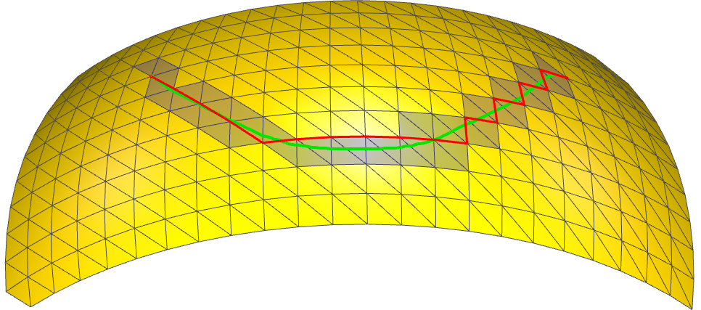
Geometry Adjustment
Second: projection onto sketch
(orthographic) viewer
v_{SC}
v_{S}
sketch
screen
n
tangent plane
n
v_{O}
v_{OC}
v₂
v₁

Slide 22
Geometry Adjustment
Second: projection onto sketch
Approximates the sketch very well
Can introduce badly shaped tri‘s
(orthographic) viewer
v_{SC}
v_{S}
sketch
screen
n
tangent plane
n
v_{O}
v_{OC}
v₂
v₁

Slide 23
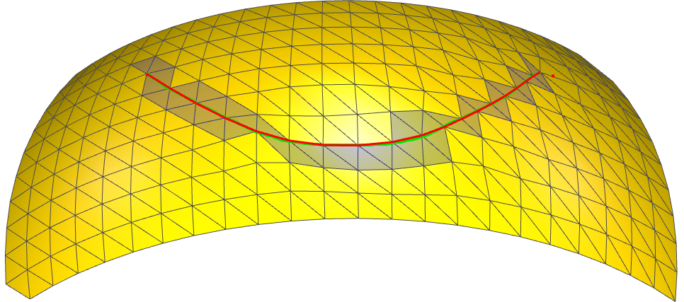
Geometry Adjustment
Third: local mesh regularization
Ask uniformly weighted Laplacian to become cotangent weighted Laplacian, while fixing path vertices
L
x
=
δ
L
x
=
δ
sketch
screen
n
v_{OC}
fix
v₂
v´₂
δ_{umbrella}
v₁
δ_{cotangent}
v´₁

Slide 24
Geometry Adjustment
Third: local mesh regularization
Well shaped triangles and nice piecewise linear approximation of the users sketch
L
x
=
δ
L
x
=
δ
sketch
screen
n
v_{OC}
fix
v´₂
δ_{cotangent}
v´₁

Slide 25
Feature Edit
Edit: scale (or add to) Laplacians
n
v_{OC}
v´₂
δ_{cotangent}
v´₁

Slide 26
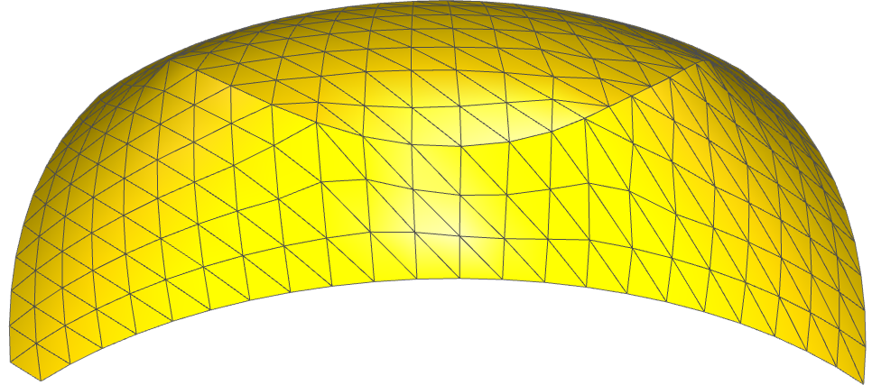
Feature Edit
Edit: scale (or add to) Laplacians
n
v´₂
δ_{cotangent}
v´₁

Slide 27
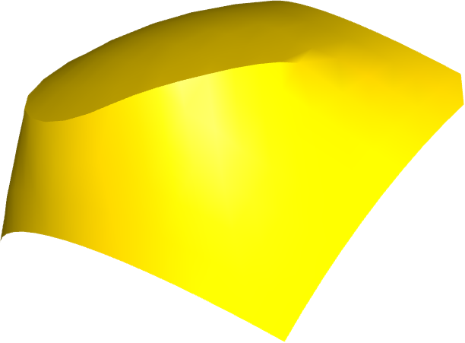
Feature Edit
n
v´₂
δ_{cotangent}
v´₁

Slide 28
Laplacian Constraints
Scale (or add to) Laplacians
n
w_{Li}
L/T_{i}
T_{i}
x
w_{Li}
δ_{x}
L/T_{i}
y
=
0
δ_{y}
δ
T_{i}
L/T_{i}
z
δ_{z}
fix
1
w₁
c₁
1
w₁
1
Normal Equations
A^{T}A
x
A^{T}
=
b
x
(A^{T}A)⁻¹
A^{T}
=
b

Slide 29
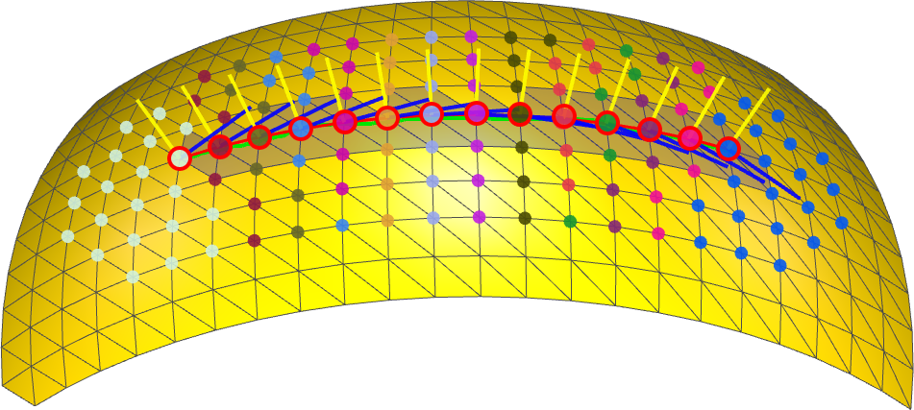
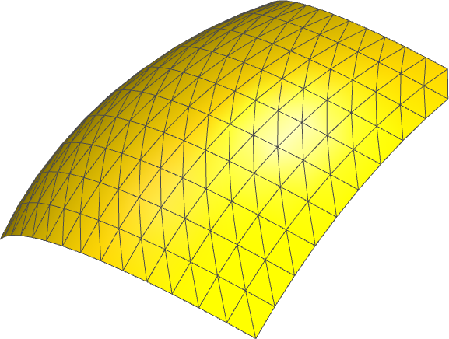
Contour Edit
radial plane
n
n_{r}
v
n
n_{r}

Slide 30
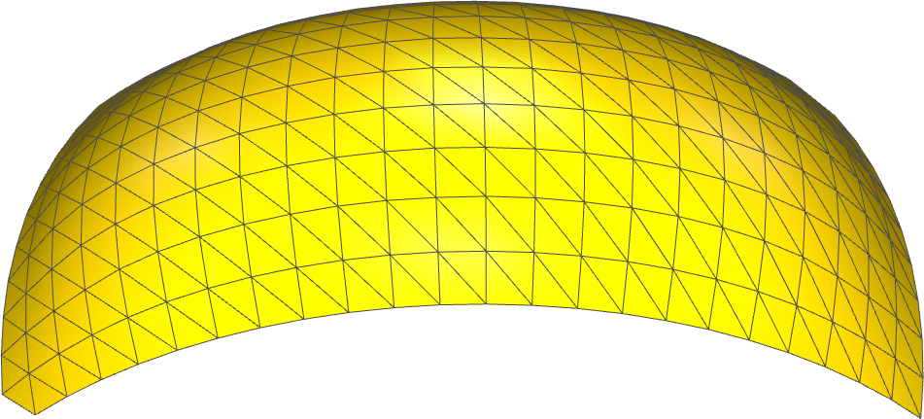
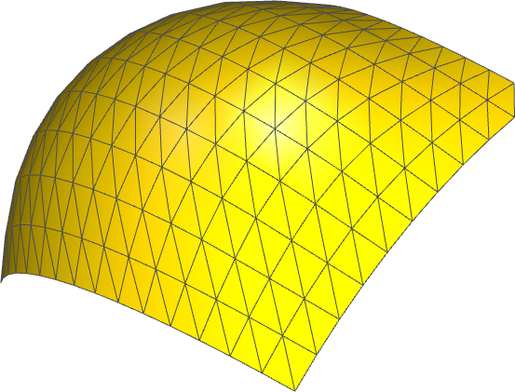
Contour Edit
radial plane
n
n_{r}
v
n
n_{r}

Slide 31
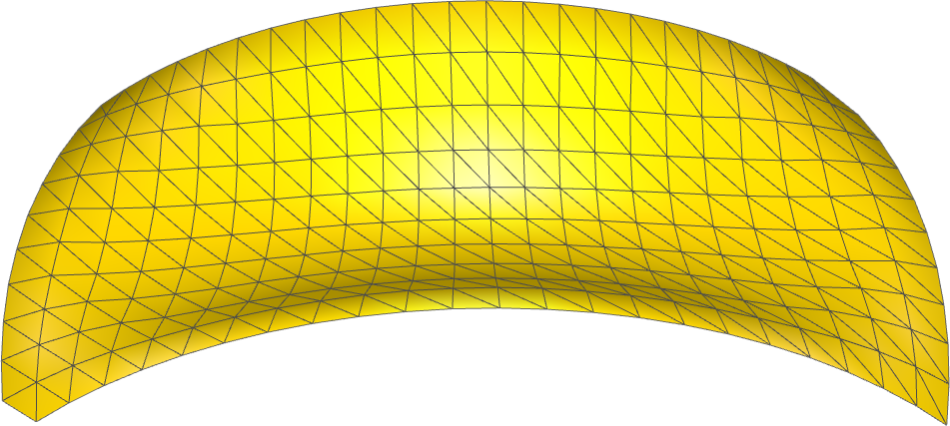
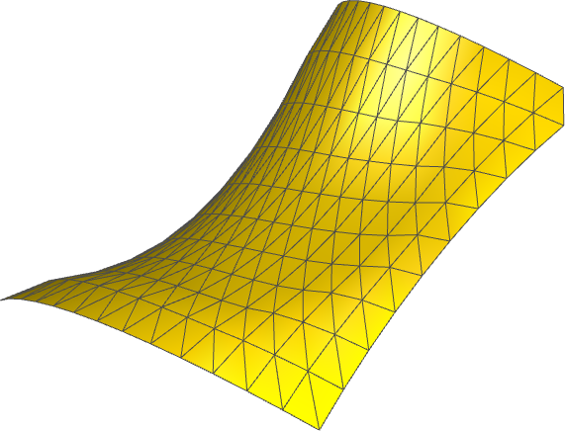
Contour Edit
radial curvature Inflection line

Slide 32
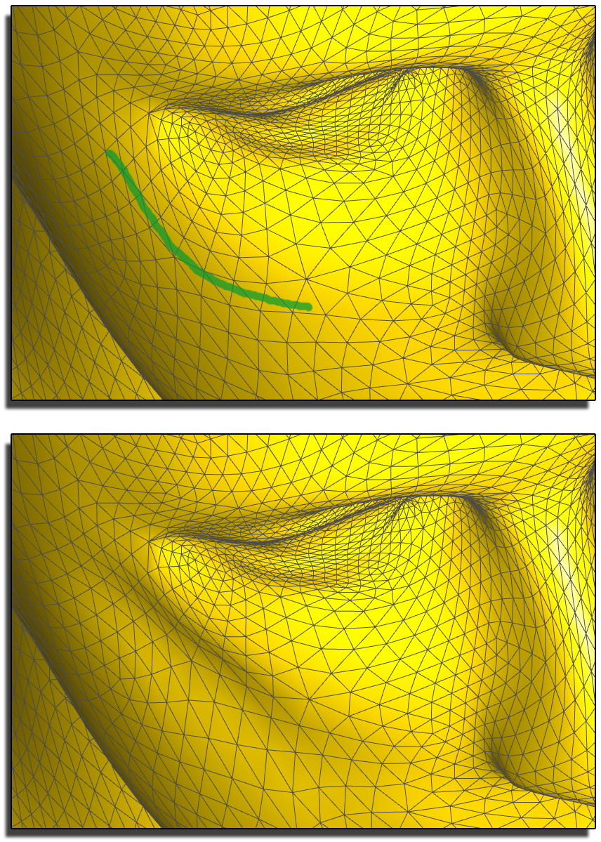
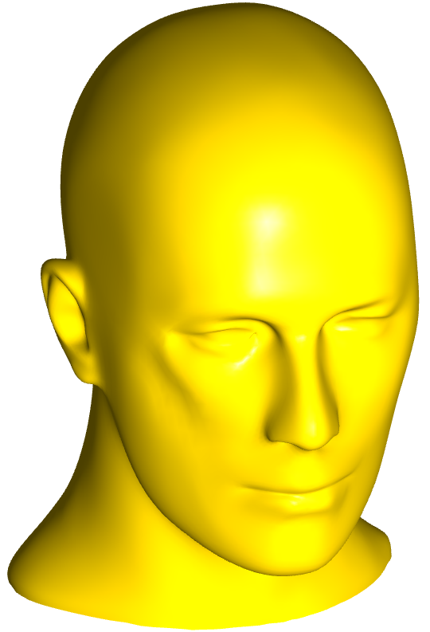
Contour Edit

Slide 33
Editing Session (1)

Slide 34
Editing Session (2)

Slide 35
Editing Session (3)

Slide 36
Editing Session (4)

Slide 37
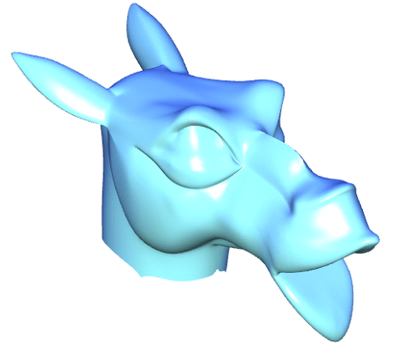
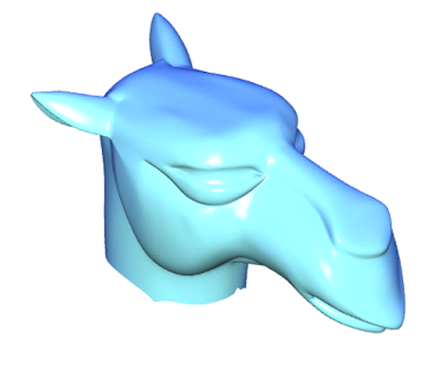
Editing Session Result

Slide 38
Discussion…
The good...
Intuitive, sketch-based User Interface for silhouette deformation and feature creation/modification
Fast model updates after sketch (Iterative Modeling)
Preserves surface detail as much as possible
... and the not so good
Object-Space sil‘s useless in the presence of heavy noise
Editing differential properties can take time to learn

Slide 39
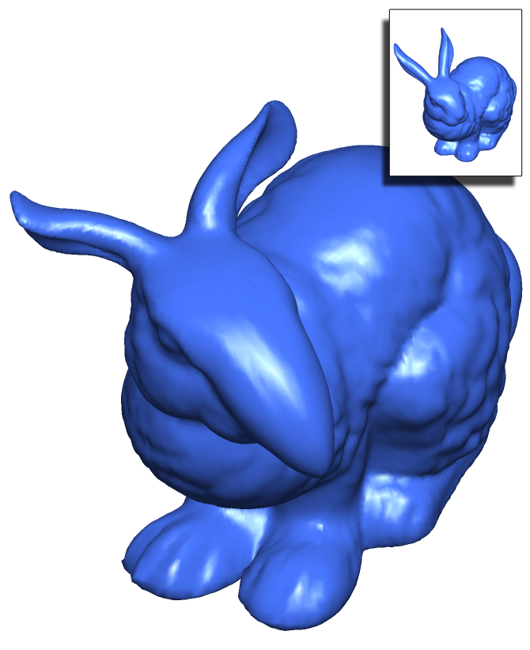
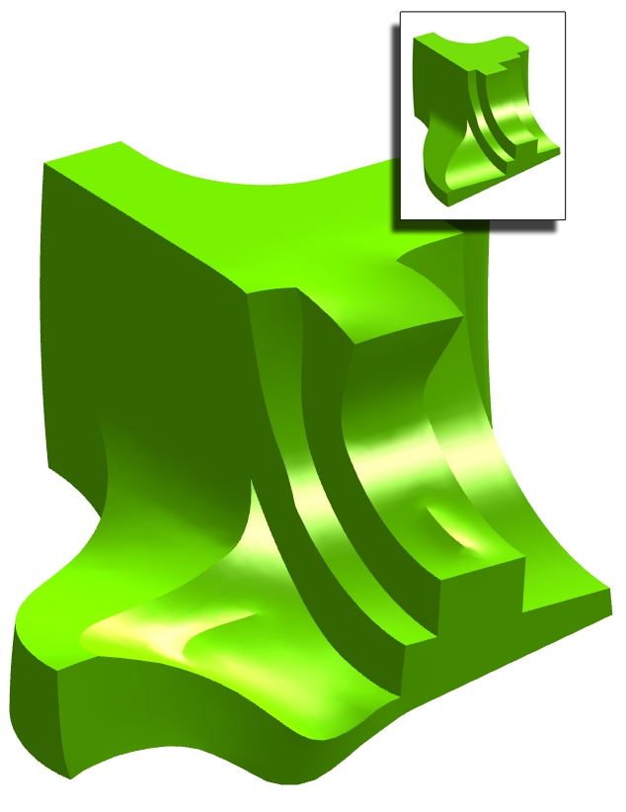
Thank You!
Contact Information
Andrew Nealen
nealen@informatik.tu-darmstadt.de
Olga Sorkine
sorkine@tau.ac.il
Marc Alexa
alexa@informatik.tu-darmstadt.de
Daniel Cohen-Or
dcor@post.tau.ac.il

Slide 40
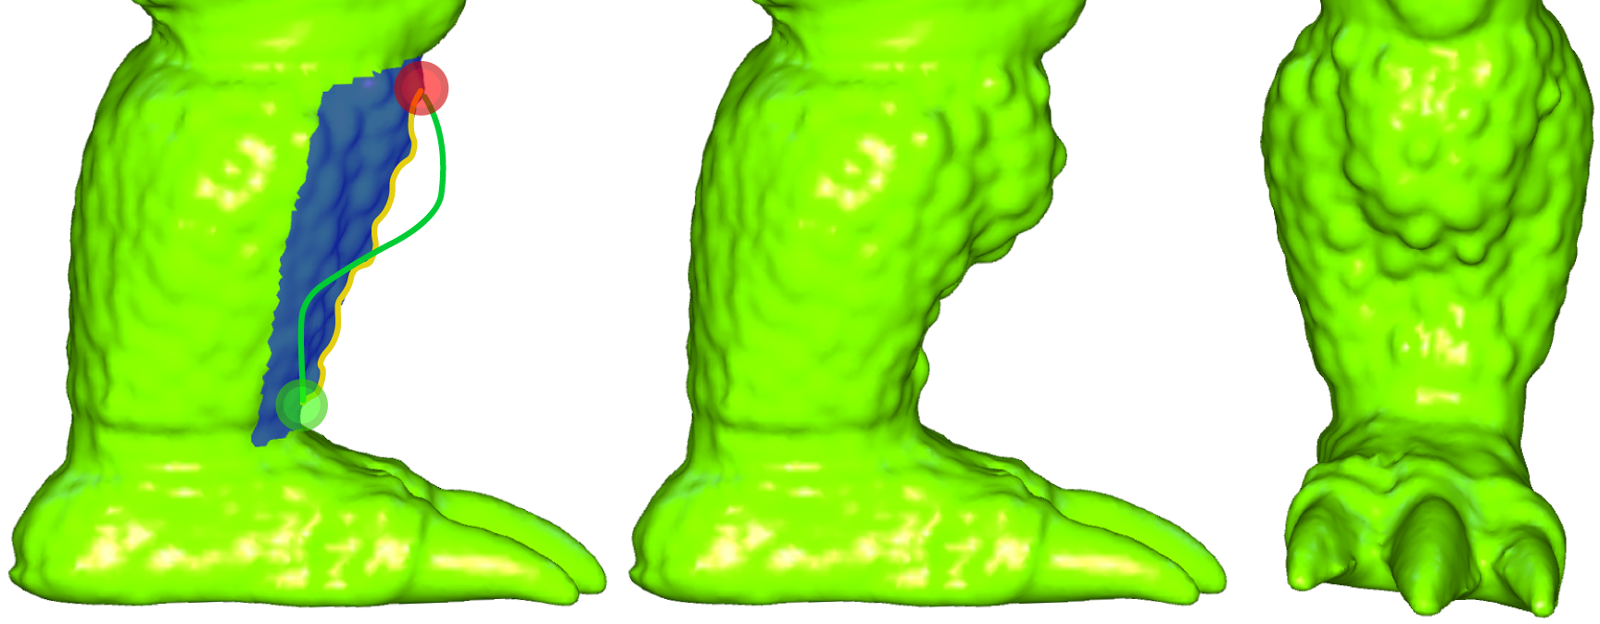
Noisy Surface Silhouette

